Slide 1

10/28/25
Humidification
Angelica Ramirez, Hiba Naqvi, Jazmin Aca, Srija Bomma

Slide 2

Table of Contents
Introduction
Theory
Apparatus
Materials and Supplies
Procedure
Dangers
Challenges

Slide 3

Introduction
The objective of this experiment is to analyze the mass and heat transfer of an air-water system in a wetted-wall humidification column by taking temperature readings at different air flow rates. By obtaining the experimental mass and heat transfer coefficients, the effect of system variables, such as inlet air temperature and flow rate, can be studied to determine if they deviate from expected correlations. This is done by testing three air flow rates at heated and unheated conditions in the humidification column.

Slide 4
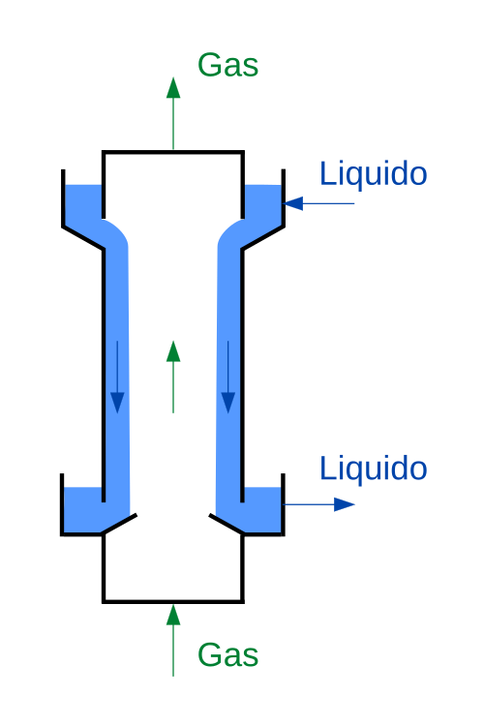
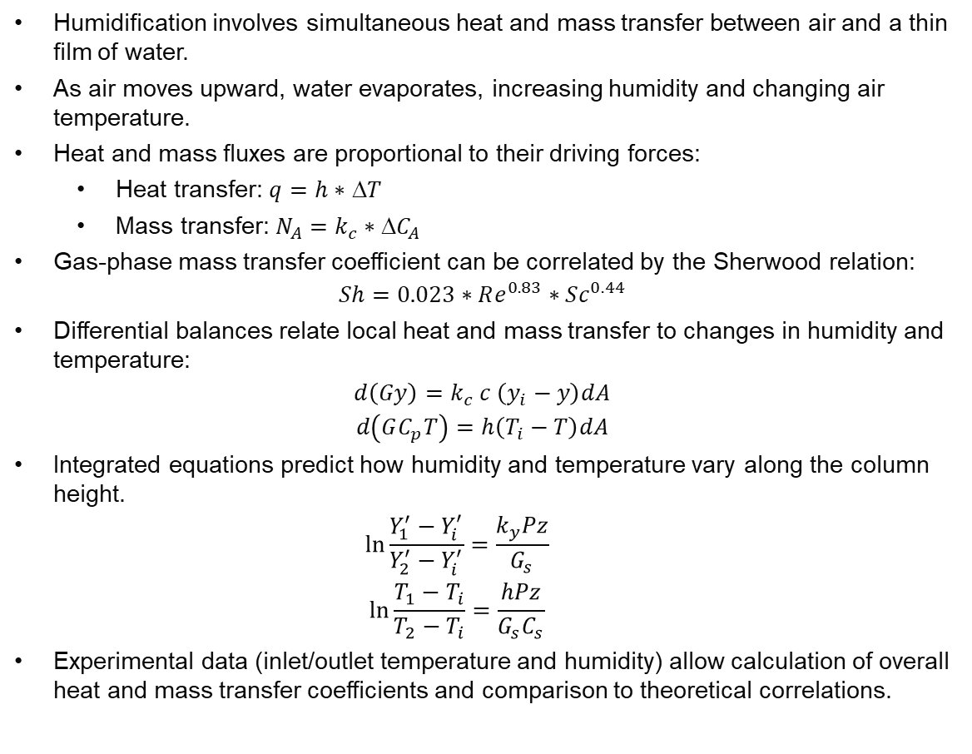
Theory
Humidification involves simultaneous heat and mass transfer between air and a thin film of water.
As air moves upward, water evaporates, increasing humidity and changing air temperature.
Heat and mass fluxes are proportional to their driving forces:
Heat transfer: $q=h∗$ Δ$T$
Mass transfer: $N_{A}=k_{c}∗{C}_{A}$
Gas-phase mass transfer coefficient can be correlated by the Sherwood relation:
$$Sh=0.023∗Re^{0.83}∗Sc^{0.44}$$
Differential balances relate local heat and mass transfer to changes in humidity and temperature:
$$d\left(Gy\right)=k_{c} c \left(y_{i}−y\right)dA$$
$$d\left(GC_{p}T\right)=h\left(T_{i}−T\right)dA$$
Integrated equations predict how humidity and temperature vary along the column height.
$$\ln{\frac{Y_{1}^{′}−Y_{i}^{′}}{Y_{2}^{′}−Y_{i}^{′}}=\frac{k_{y}Pz}{G_{s}}}$$
$$\ln{\frac{T_{1}−T_{i}}{T_{2}−T_{i}}=\frac{hPz}{G_{s}C_{s}}}$$
Experimental data (inlet/outlet temperature and humidity) allow calculation of overall heat and mass transfer coefficients and comparison to theoretical correlations.

Slide 5
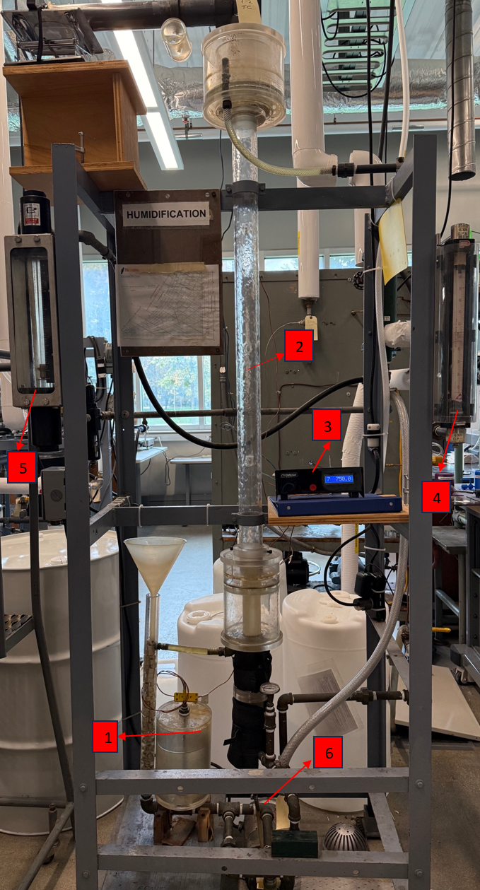
Apparatus
Reservoir: Container that stores the DI water.
Humidification column: Plexiglass column where air humidification will occur.
Digital display: displays temperature values read by thermocouples
Water Rotameter: Measures the water recirculation rate.
Air Rotameter: Measures air inlet flow rate.
Pump: Circulates DI water through the humidification column.
Thermocouples: Measure temperature values at different points of the humidification unit.
7

Slide 6
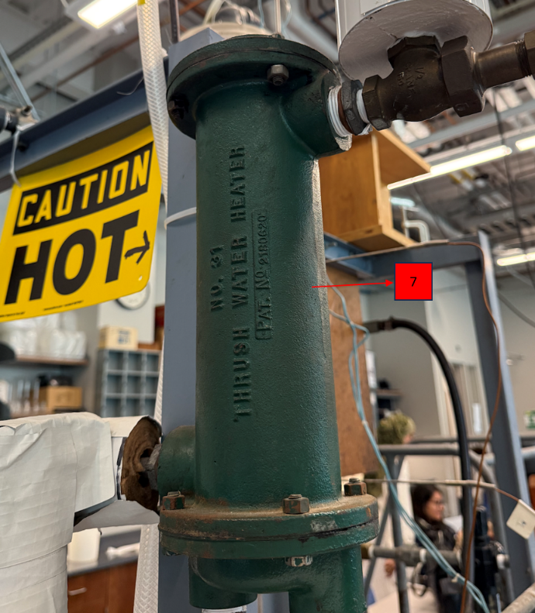
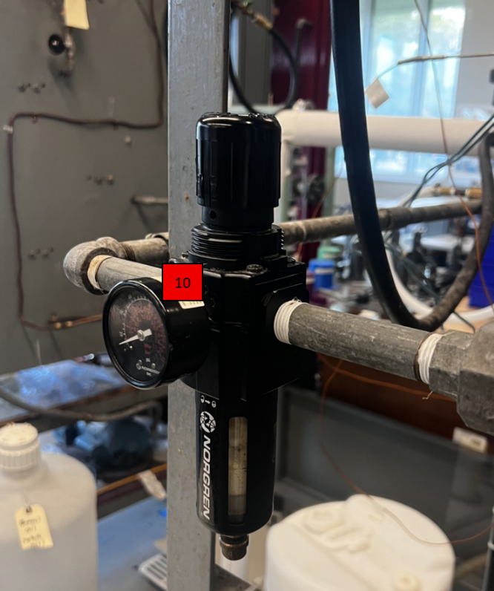
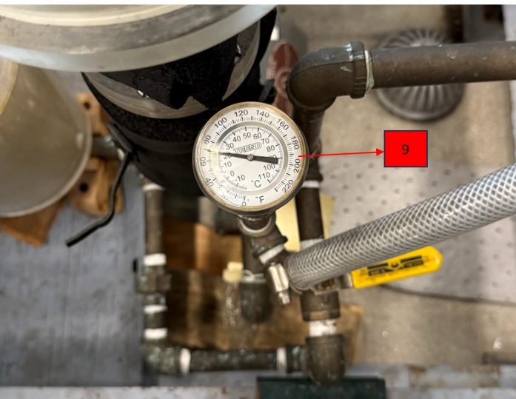
Apparatus
8
7. Heat Exchanger: Heats up air that is entering the column
9. Analog Thermometer: Used to read the temperature of the inlet air
10. Pressure Regulator: Regulates the pressure of the inlet air.
10

Slide 7

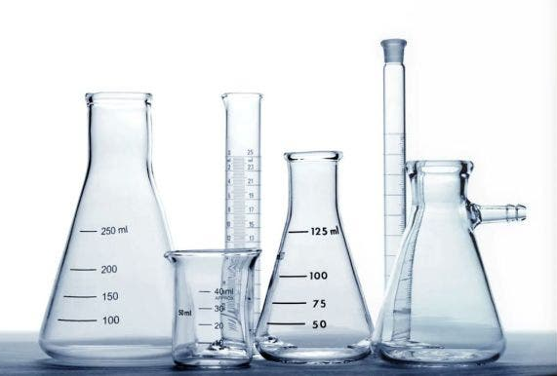
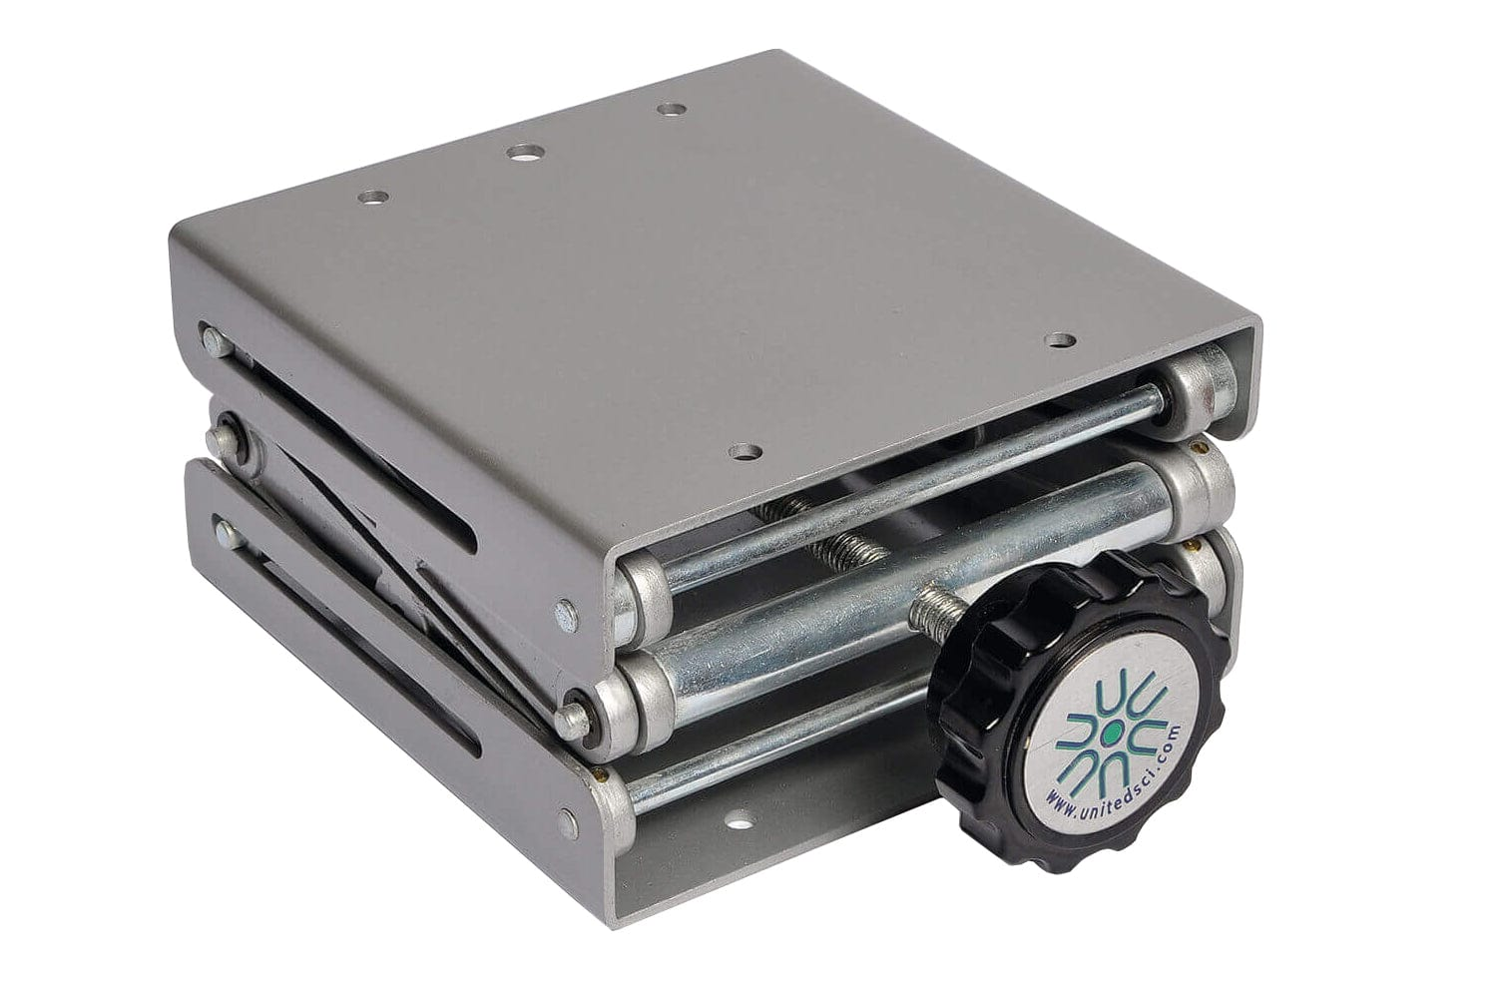
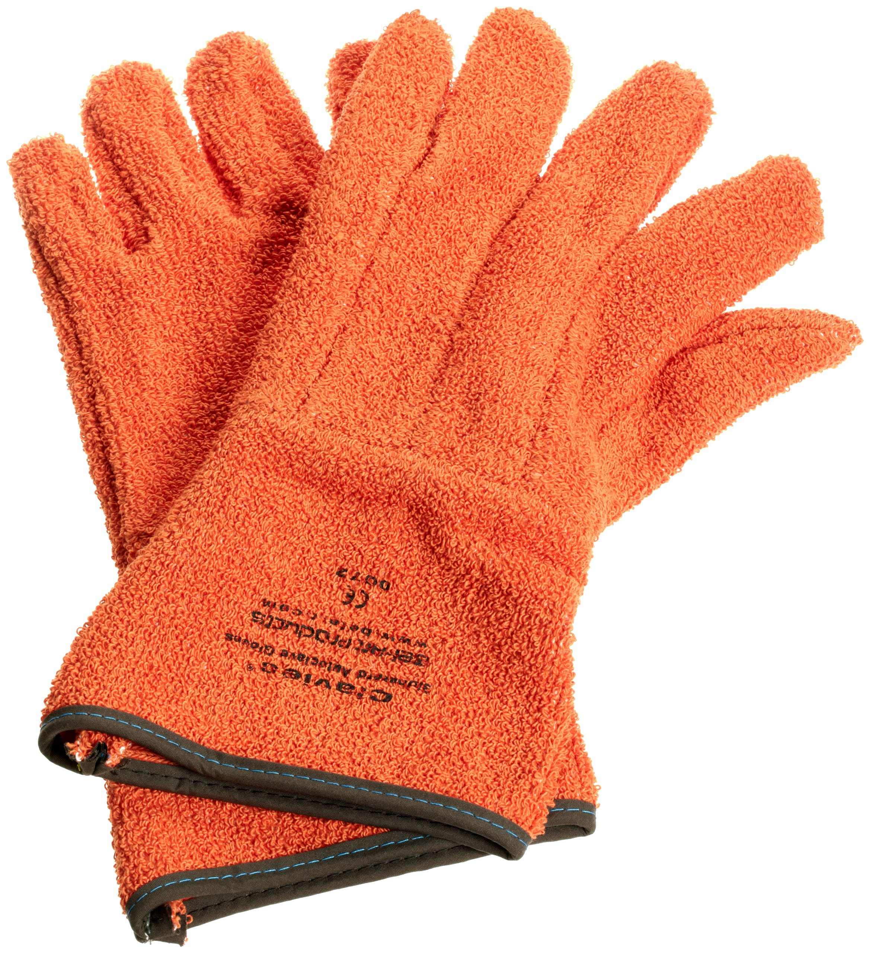
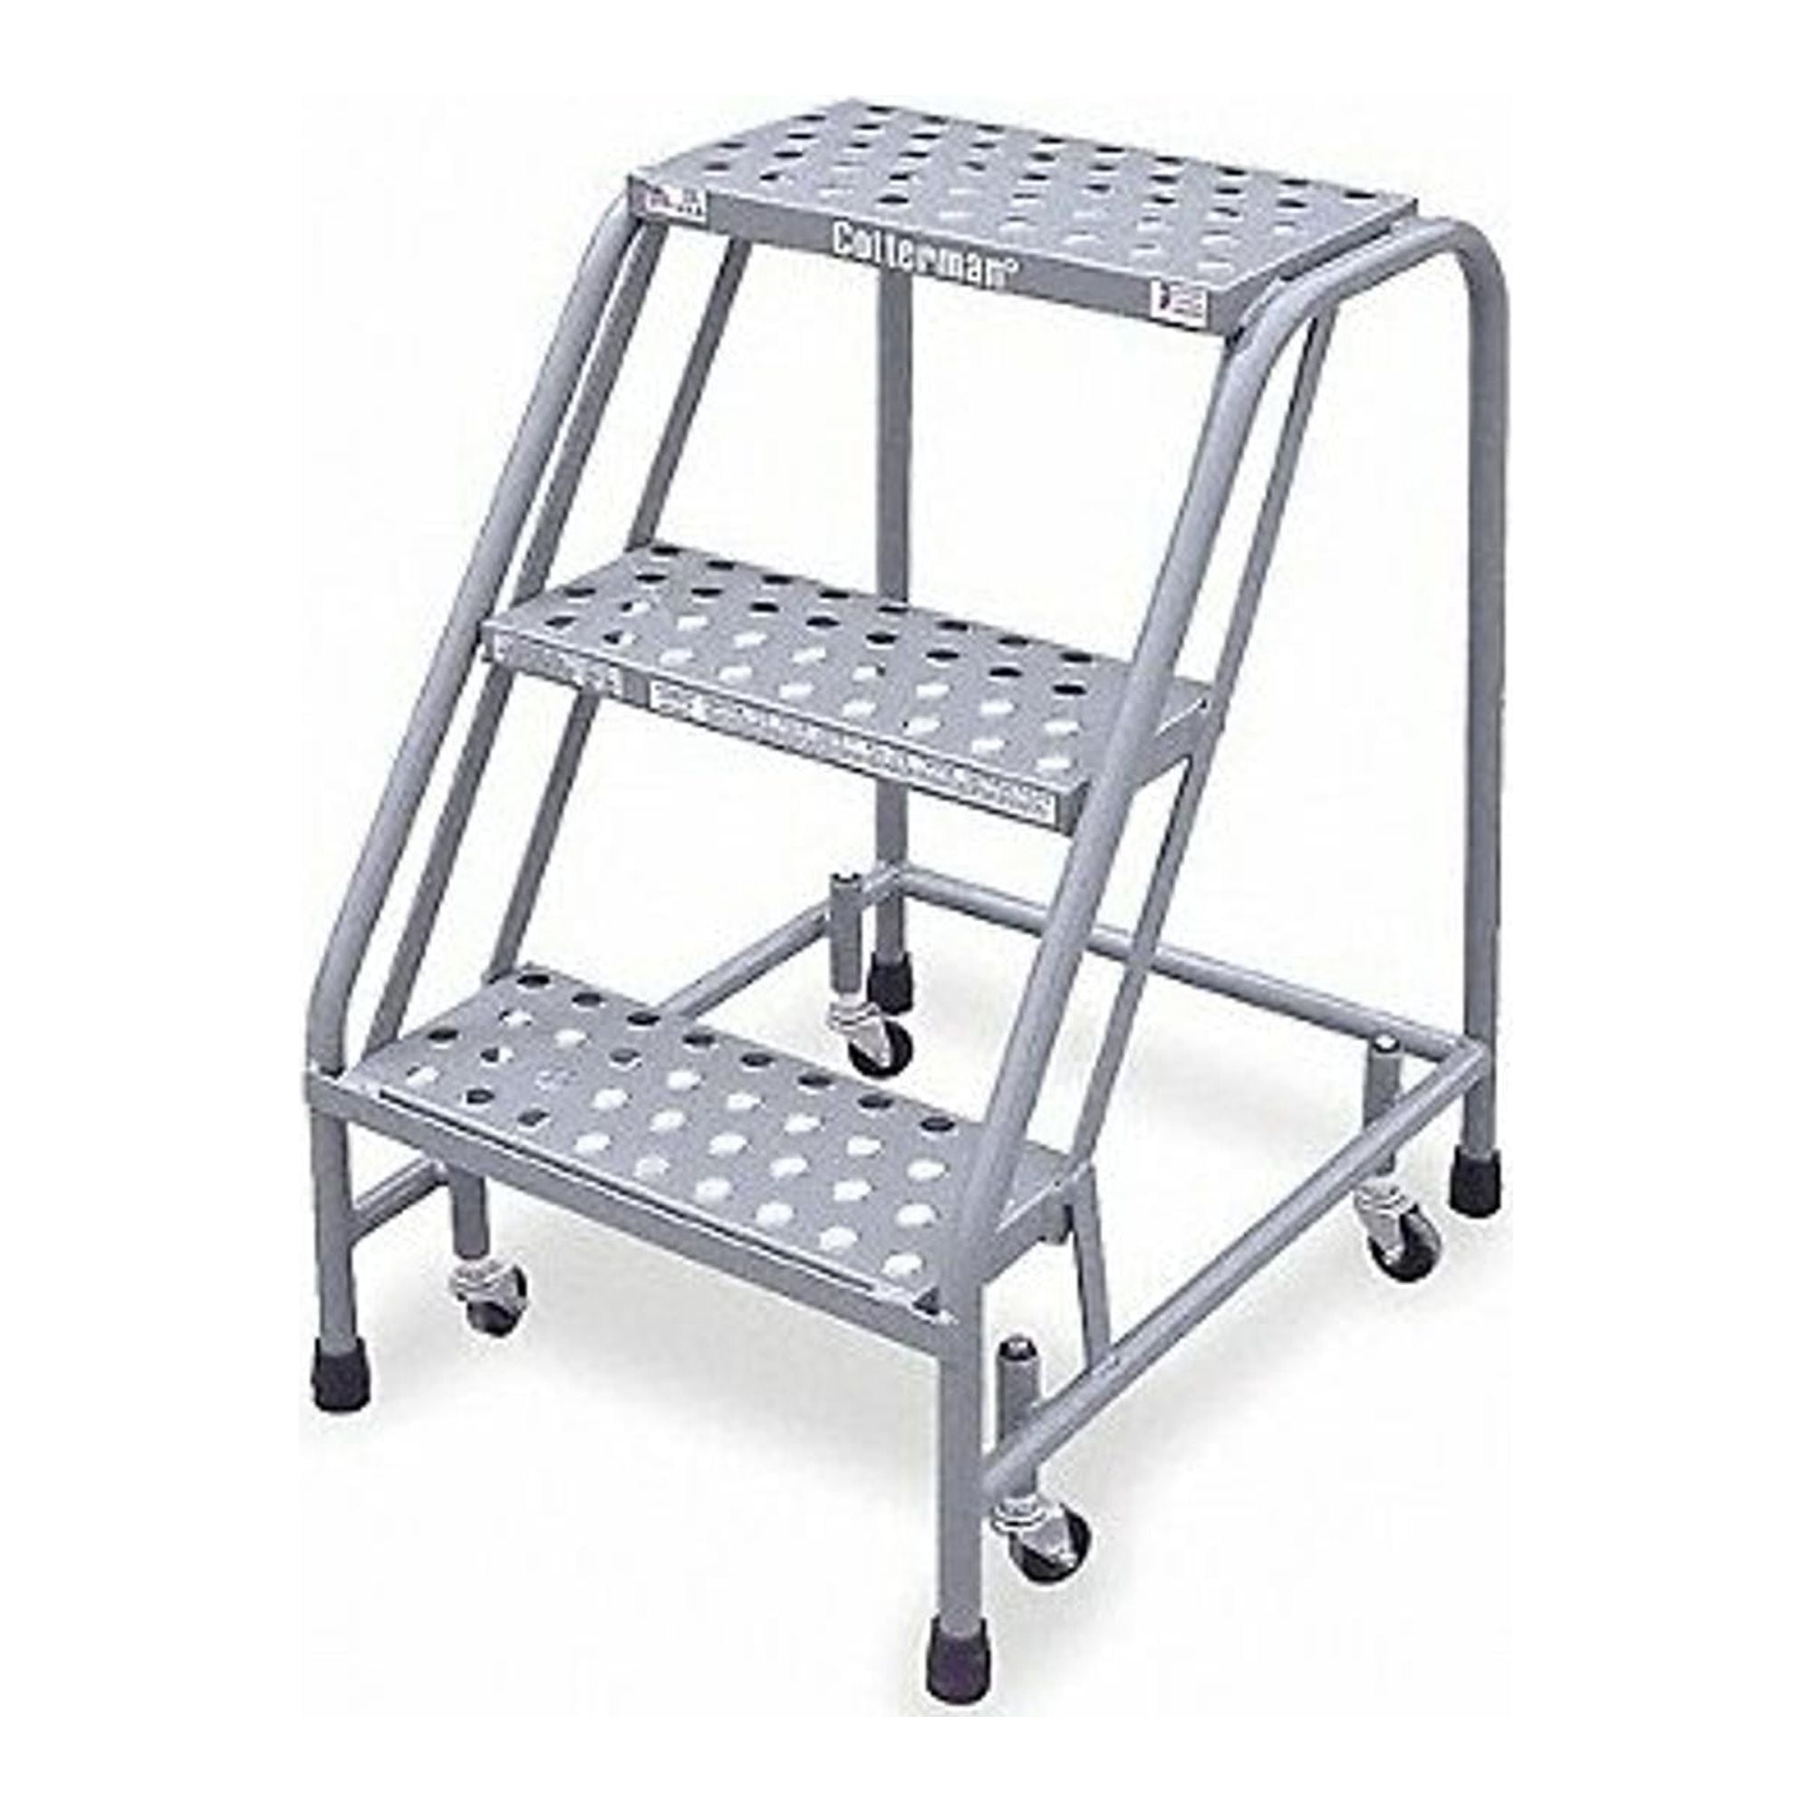
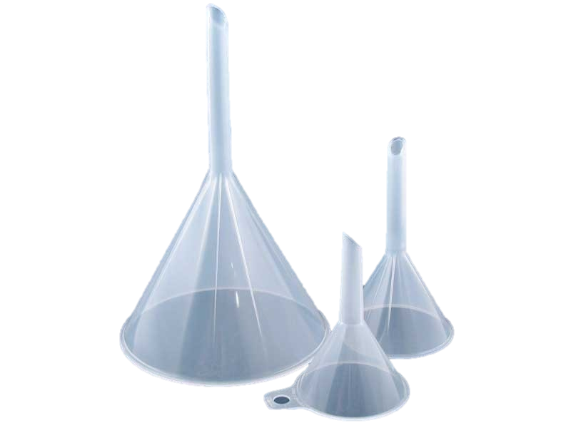
Materials and Supplies
Water
Compressed Air
Hygrometer
Funnel
Beaker
Safety Goggles
Heat Gloves
Steam
Step Ladder
Lab Jack

Slide 8

Dry Air:
Fill the water tank with deionized water.
Turn on the compressed air flow and record inlet pressure.
Turn on the digital temperature reader.
Record the temperature readings TC 1-6 from the digital temperature reader and the temperature analog gauge at the bottom of the column.
Record the humidity and temperature of the dry air using a hygrometer.
Do this for flow rates of 2, 4, and 6 scfm.
Open the steam valve to allow steam to enter the heat exchanger.
Repeat steps 4 to 6 for a warm temperature and a high temperature.
Humidification:
9. Start the flow of water.
10. Allow water to overflow the column and then decrease flow to a steady state.
11. Set the air flow rate to a chosen value.
12. Allow column to stabilize and record the temperature readings TC 1-6 and the inlet temperature.
13. Measure the humidity of the outlet air with the hygrometer.
14. Repeat for flow rates of 2, 4, and 6 scfm.
15. Open the steam valve to allow steam to enter the heat exchanger.
16. Repeat steps 12 to 14 for a warm temperature and a high temperature.
Note: Temperature can be varied by changing the flow of steam into the heat exchanger.
Procedure

Slide 9
Dangers
Highly compressed air needs to be controlled. Keep it under 120 psig
Water can potentially get into thermocouple reader and pump
Steam valve and outlet air will be at high temperatures
Do not run the pump without water

Slide 10
Challenges
Have someone recording values consistently
Allow the system to stabilize between trials before recording any data
Be organized with the trials so that the post-lab process is easier

